Slide 1
AOSE Development Kit 2018: A hybrid BDI / PDDL Multi-Agent System
May 2018
Marco Robol - marco.robol@unitn.it
Paolo Busetta – paolo.busetta@gmail.com
In collaboration with

Slide 2
ADK2018: Purpose and Approach
Showing how to put together PDDL and a practical reasoning system (BDI inspired) to build autonomous entities – i.e., a hybrid agent architecture
Modelling multi-agent actions in a single plan and using different approaches to execution (collaborative vs hierarchical)
Demonstrating how to build a (simplified) BDI multi-agent system
Implementation: A Java-based simulator but with a simplified world representation and planning (directly in PDDL)
Planning performed by blackbox on a domain determined by agents (hardwired in examples)
Action executions on the world change the PDDL world representation, directly from Java code
The agent computational model, including sensing and meta-reasoning concerning priorities, conflicts, collaboration, error and retry management, etc. … in native Java
Infrastructural code independent of domain. Some Java code (e.g. actions) domain dependent.

Slide 3
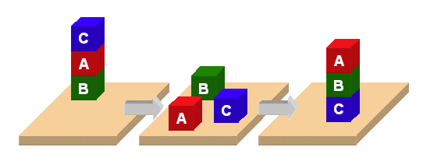
The example domain: Blocks world
Adopting the most basic PDDL example
Only a few basic actions (pickup, putdown, stack, unstack)
But, two or more handles, each managed by an autonomous robot using PDDL to reach its goals
picture courtesy of UBMC.
https://www.csee.umbc.edu/courses/graduate/671/fall15/hw/hw6/

Slide 4
Simulator
Architecture
Acting Agent 2
Acting Agent 1
Acting Agent N
ENVIRONMENT
agent
Requests (PDDL goals, PDDL Actions,
Sensing)
Information (PDDL clauses)
Each agent has its own execution thread. All agents reside in a single Java process

Slide 5
Agents
As Event-Driven
Queue
Processors
Acting Agent 1
mqueue
Message Queue
Handle
waitingIntention
Intention Queue
Postman Intention
Push goal
(from any intention or other Java code)
Perform step
Push message
(from any intention or
any other Java code)
GeneralAgent.run()
executor thread invoking:
SchedulediIntention.execute()
invoking
Intention’s next step
while checking maintenance condition
Acting Agent n
Message Queue
(Sub-goals failure not well supported at the moment)

Slide 6
Using a simulation timer for activity scheduling and timeouts
Wall-clock: System.currentTimeMillis()
Using an application-managed timer, rather than the system clock, simplifies the implementation of functionality such as:
Pause and resume of activities
Test repeatability (using relative time rather than wall-clock)
An agent’s waitingIntention (a SchedulingQueue) keeps the list of activities ready to run now and those scheduled for a future time, in FIFO order (no prioritization).
Plans are implemented as ScheduledIntentions. Timers (e.g. for maintenance conditions) are java.lang.Observers.
Both are offer()ed to waitingIntention.
waitingIntention maintains its own internal timer.
The timer of the Environment agent (singleton, use Environment.getEnvironment()) is considered the MAS’ timer.
Notable Environment’s static methods:
getSimulationTime()
pauseSimulationTime()
resumeSimulationTime()

Slide 7
Setting up the simulation: PDDL domain and the Environment agent
Refer to BlocksworldLauncher.main() as example
Create a PddlDomain object, with the PDDL domain file in input
Add the PDDL actions which are supported (i.e. the corresponding Java classes implementing changes to the world)
These should be executed only by the Environment agent
Create and set up the Environment agent (see next for general agent setup)
The environment manages the goal to handle messages (Postman_goal), the generic event corresponding to a request to perform a PDDL action (PddlAction_msg), the request for sensor readings (Sensing_msg)

Slide 8
Setting up the simulation: Constructing a (domain-specific) agent
Refer to BlocksworldLauncher.main() as example
Instantiate unitn.adk2018.generic_agent.General_agent
Add the events it handles– in particular, goals and subgoals – and, for each, the corresponding intention(s)
a la JACK: an “event” class and one or more “intention” classes
A context() method (similar to JACK) can be used to select the right intention
The first one (in order of addition) with context() true is picked – further discussed later
Don’t forget the Postman_goal and its intention to handle input messages (see later)

Slide 9
Updating Beliefs
An information message
that triggers a Clause_intention
Clause Message
Agent Beliefs
concerning
the world
PDDL Clauses
Clause_intention copies the clause
Simulating sensor readings:
This is not realistic, strictly speaking, but simplifies the exercise
More realistically, data would be kept in language-specific structures and converted to PDDL only when required (and limited to the relevant planning information)
Any agent
(2..n) Clause Message
ENVIRONMENT
agent
(1) Sensing Message

Slide 10
An intention in summary
A subclass of Intention
Intention<> is a generic that has to be specialized for a goal type
A Boolean context(Agent,Goal-type-from-generic) method returns true if it is applicable at the time of invocation
The selection logic, in General_agent, goes thru the list of intention classes added for that goal type for that agent and picks the first intention whose context is true
Default is true
There must be a step0 method, performing the first step
Each step-executing method returns a Next object, with the name of the next step-executing method including when to run (a time or a condition), or null if done with success
waitFor, waitUntil helps building nexts, for a time or a condition respectively
The way to fail an intention is by returning a next with null as step-executing method or by calling interrupt() when not executing (e.g. from another intention or a maintenance condition)
Ovveride pass() or fail() when required

Slide 11
Using dynamic PDDL planning rather than BDI procedures
The entire agent logics can be hardcoded in Java, using intentions of course
More interesting is to use PDDL. BDI-style logic, discussed in next slides, show the sequence of goals, subgoals, messages that implement the invocation of the PDDL planner and the execution of its steps
In the example block world domain, PDDL generates multi-agent plans, i.e. actions are annotated with the robot that has to execute the action
PDDL plans, by constructions, check no conditions and do not adapt to changing conditions. This execution monitoring and possibly replanning is left to the agent
The approach in the current demo is very basic: try running until an action fails
Extensions, to deal with failures, replanning, introspections, coordination among agents are left to your projects

Slide 12
Reaching a goal via PDDL planning
Payload:
A list of PDDL clauses representing the goal (i.e. the desired world state, in AND)
ReachPDDLGoal
PddlDomain:
Knows domain file name
Knows supported actions
One per environment
Set up at the beginning
ReachPDDGoal_Intention:
Sense the current world (sensing goal) to update the beliefs
Call blackbox to plan reach the goal with the current agent beliefs
Output: a PddlPlan (a list of PddlSteps)
pushGoal ExecutePDDL (PddlPlan)
Blackbox Utils:
Wraps blackbox
Creates a new PDDL “problem file” in a ”tmp” subdir at each run
ExecutePDDL Intention
For each PDDL Step:
Submit a PDDLStep goal (possibly in parallel with previous)
Context: <action> and executor (from planning): another agent
Body: queue a Request with a ReachPDDLGoal to destination
[recursively causing PDDL planning]
PDDL Step
intention
Context: default
Body: submit PddlAction_msg to environment
PDDL Step
<Action specific>
Ask Help Intention

Slide 13
Changing the environment by executing planned actions
To be executed only in Environment
In reaction to a PDDL_Action msg
PDDLAction intention
Generate a PDDLAction object, whose general workflow is:
Check preconditions (on the beliefs)
Wait an amount of time to simulate execution
Recheck precondition and, if good, assert post-conditions (on the beliefs)
Importantly:
No direct effects on the requester’s beliefs – sensing is required to get updates
Multiple actions (possibly requested from different agents) may interleave – that’s why preconditions are rechecked after simulated execution

Slide 14
From messages to goals
Postman Intention
(base one)
Delivers information ASAP by pushing it as a goal (assuming that there is an intention to handle an information and assuming strictly FIFO execution of intentions)
Keeps only the latest request (ignoring any previous one ) to process it after all infos
Message management
selected as intention for Postman_goal
on agent creation
… not actual
subclasses,
but conceptually
they are
PostmanEverythingInParallel Intention
Delivers everything ASAP
- Used by the Environment
BDI meta reasoning in General_agent
Looks for first intention whose context is true
Invoked from Agent.pushGoal
Hashmap event / msg type -> intention type
Context condition as an overridable method
No BDI-style repeat on failure!
Delivers information ASAP
Processes the first available request after all infos, keeping the others in the queue
- Used by current robots
PostmanOneRequestAtTime Intention

Slide 15
Agent communication, in-memory style
The simplicistic simulation environment doesn’t use networking at the moment
Messages are simply subclasses of InformMessage and RequestMessage
Inform / Request are inspired by Speech Acts
Their distinction is mainly to drive the Postman_goal handling logic
Messages are all subclasses of a generic Event
At destination, they are directly handled as events (see Postman’s intentions)
Messages are simply queued to destination with Environment.getEnvironment().sendMessage()
Messages, being Events, can be monitored for handling even from other agents – wasHandled() and its variants return conditions that can be used as nexts in intentions

Slide 16
Supporting BDI meta-reasoning
ADK2018 is very simplistic when compared to JACK – but that notwithstanding it is not straightforward to develop and understand.
Part of the event–management logic is in the intention handling the Postman_goal
Intention execution has some interesting capability (e.g. maintenance conditions) but needs improvement to fully implement BDI, e.g.
retry-on-failure is not supported
no prioritization – strictly FIFO with steps interleaving
Introspection is supported by analyzing the agent’s queue and using Java reflection. For instance, intentions, both queued and waiting, can be analyzed and manipulated
Plan selection at the moment is very primitive - context() is a simple Boolean (equivalent to JACK’s relevant()). No plan choice is supported

Slide 17
Debugging & Tracing tools
Learn to use the Eclipse debugger!
Each agent has a “debugOn” flag. If true, many tracing messages are printed on the standard output by that agent and can be used to understand what is going on.
By convention, tracing code follows this pattern:
if (agent.debugOn)
Logger( agent, … string … )
Environment.printStackTrace() is a simple utility that can be put in any arbitrary piece of code to understand how it got there…
There are some GUIs that will be described later

Slide 18
Demonstrating results
The easiest (which can be used also for debugging) is
<your agent>.printFullState()
for all your agents, including environment, and check that it contains what it was expected.
It writes the state of PDDL beliefs, known intentions and ready-to-run or delayed intentions on standard error, which conveniently is written in red by Eclipse on its built-in console. On a command line, you can redirect output (e.g. java “your agent system” 2> ”your file” on a Linux shell)
See example in BlockswordLauncher

Slide 19
Source code organization

Slide 20
Github
3 Eclipse projects in three repositories:
Core of the multi-agent system (Do changes only in the case of bugs) https://github.com/marcorobol/AoseDevKit2018-MultiAgentSystem
Generic goals and intentions (you could need to add goals and intentions) https://github.com/marcorobol/AoseDevKit2018-Generic
An example in the blocks-world domain (work here or on a copy) https://github.com/marcorobol/AoseDevKit2018-Blocksworld
Fork the repositories in your github account before cloning them locally.

Slide 21
Installing and running
Prerequisites: Git + Eclipse + JDK 1.8
Clone the 3 repositories: $ git clone xxx
Import the projects in Eclipse: File -> Import -> Existing Projects into Workspace
[Only for Linux/Mac users] Give execution permission to blackbox executable in the folder 2018-AoseDevKit-Blocksworld/blackbox: $ chmod +x blackbox
[Only if you have multiple versions of Java] In the case Eclipse detects errors in the projects, right click on each of them and select: Properties -> Java Compiler -> Enable project specific setting -> Compiler 1.8 or in the Eclipse preferences set default compiler to Java 1.8
To run the blocksworld example, in the project AoseDevKit2018-Blocksworld right click on file unitn.adk2018.blocksworld.BlocksworldLauncher and select: Run as -> Java Application

Slide 22
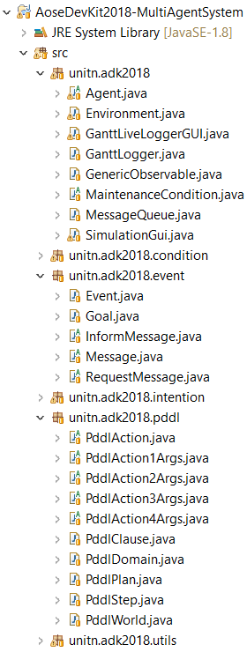
Multi-agent system project
Core of our multi-threading MAS
Domain-independent
Make changes to this code only in the case of bugs!
In the case of bugs, let us know or fix them and do a pull request
APIs: Agent and Environment classes
Abstract classes to be extended: Goal, InformMessage, RequestMessage, Intention, PddlAction*Args

Slide 23
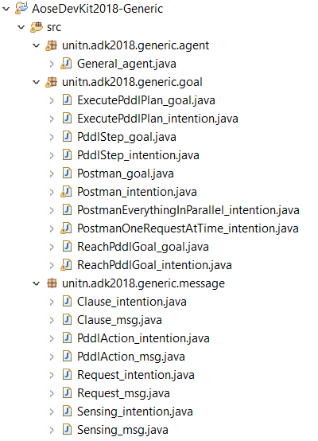
Goals and intentions project
General agents, messages/goals and intentions
Domain-independent
You could need to add new goals or intentions (just be sure that they are domain-independent)
In the case of bugs, let us know or fix them and do a pull request

Slide 24
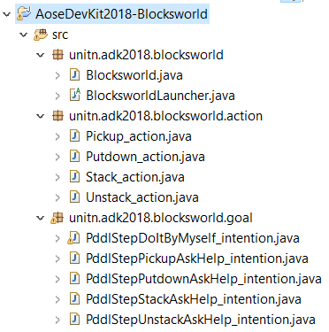
The Blocksworld project
An example in the blocks-world domain
Domain-specific
Pddl domain file + java version of pddl actions
Domain-specific intentions for the “PddlStep_goal”
To start, run the BlocksworldLaucher
Work on this project if you extend this domain
Create a copy of the project for other domains
In the case of bugs, let us know or fix them and do a pull request.

Slide 25
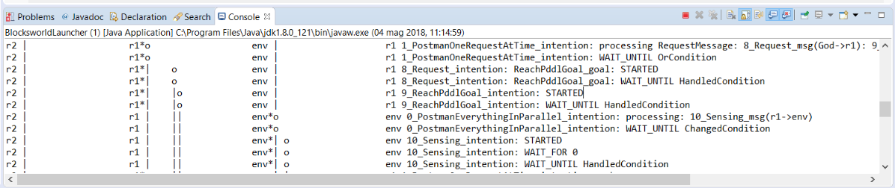
Logger
First columns of the logs are dedicated to represent a sort of GANTT diagram placed vertically
The logger can be configured to set the size of this columns and the number of agents and intentions supported
In the example of above, three robots are running. In r2 a single intention is alive probably waiting for something. In r1 the PostmanOneRequestAtTime intention is logging some messages in the first two lines, and then it starts a Request intention and ReachPddlGoal intention. Something similar happens for the env agent.
Intentions are assigned with an incremental id unique in the simulation.

Slide 26
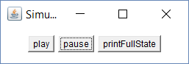
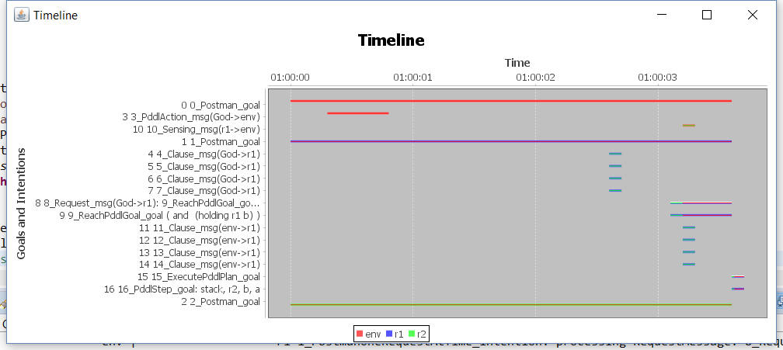
GUIs
A gui for controlling the simulation
A timeline of intentions

Slide 27
Exercises

Slide 28
Exercises: Basics
Add blocks to the world. Request non conflictual operations to robots (e.g., stack two different sets of blocks)
Request conflictual operations and see how preconditions fail. Introduce replanning on error until successful
Create a collaboration situation:
Robot A pickup a block (keeping it until requested)
Robot B has to create a stack. Thus, it generates an action to be dispatched to second robot

Slide 29
Exercises: Review sensing
Update the requester’s beliefs after every action successfully executed by the environment
i.e., the acting agent believes the post conditions of its successful actions
but, the other agents are not updated
Do precondition checks directly in the acting agent (must be repeated anyway by the environment, which has the complete picture)
Update all agents’ beliefs after every successful action by Environment
i.e., sensing is performed in real-time by all at the same time

Slide 30
Project suggestions

Slide 31
(Easy) Extending / changing domain
Support a new domain
You may take inspiration from one of the examples distributed with blackbox
Show: new types of actions, new types of sensing, …
Support different agent types with different domains

Slide 32
(Medium) Introduce MAS and multi-goals management
Introduce a “coordinator” agent, with prebuilt logic (intentions), and direct requests to it rather than “working” agents. Manage:
Requests that can be performed in parallel
Requests that require collaboration
Introduce a temporary change of objectives. For instance, ask A to stack a set of blocks; B starts just after but with one of the same blocks of A; let A be interrupted when requested, help B to build his stack first, then restart (by dismantling B’s stack)
Requires introspection, a way to suspend a plan or to delay a goal, coordination on priority and completion of tasks

Slide 33
(Medium-hard) Improve BDI management
Add BDI-style retry on failure (see pushGoal, doBDIMetaReasoning)
For Reach PDDL goals only
For all goals
Introduce more sophisticated multi-goal management, with a set of features that may include: priorities; ability to delay goals until condition reached; pause of execution of an intention and restarts; meta-rules identifying conflicts…
Start by designing a domain and a set of goals where conflicts and multitask are required
You may define a taxonomy of goals and corresponding PDDL clauses, rather than work directly in PDDL (much more user-friendly, goals themselves may be results of reasoning)
In combination with sensing changes:
Better maintenance conditions: fail a plan when sensing reports unreacheable action / goal or already failed
Replan on any unexpected change (i.e. not the postconditions of current actions)
Other conditions you may think of

Slide 34
The “ideal” project
Combine one easy, one medium, and one hard task
For instance: create a new domain, put a team of agents doing different things, give them multiple tasks in parallel that may require prioritization or solution of conflicts

